Slide 1

An Investigation Into The Benefits and Limitations of Machine Learning Models for Diabetes Risk Prediction
School of Computing, Engineering & Digital Technologies | Teesside University, Middlesbrough, Tees Valley, TS1 3BX UK
Babatunde Abiodun Olusegun | B1605208 | Supervisor: Iqbal Zahid | 16th January 2024.

Slide 2
OUTLINE
INTRODUCTION AND BACKGROUND
EXISTING ISSUES
PROBLEM SOLUTION
METHODOLOGY
EVALUATION AND RESULTS
CONCLUSION

Slide 3

INTRODUCTION
Based on the data from I.D.F. Diabetes Atlas, it is projected that in 2021, there were approximately 536.6 million adults aged 20-79 with diabetes across 215 nations and territories. By 2045, it is projected that 783.2 million people will have Diabetes (Sun H. et al., 2022).
There are primarily two classes of diabetes, namely,
- Type-1 Diabetes is caused by the inability of the human body to generate sufficient insulin.
- Type-2 Diabetes which is the focus of this research, is a chronic condition where the body becomes resistant to insulin or doesn’t produce enough, leading to high blood sugar levels. It's often associated with obesity, inactivity, and poor diet, and usually develops in adulthood. Management involves lifestyle changes, blood sugar monitoring, and possibly medication or insulin.
Research Aims and objectives
This research project investigates the impact of identified lifestyles and other risk factors on prevalence of diabetics in people.
The study investigates the significance of machine learning models in diabetics risk prediction among varying existing issues and challenges.
The research project studies the past literature work in the diagnosis, identification, treatment, and prediction of diabetes using varying machine learning models.

Slide 4
EXISTING ISSUES
Data Quality and Bias: Self-reported lifestyle factor data, which are frequently employed in research, are frequently untrustworthy. Recall bias has been shown to influence study outcomes, and it is difficult to quantify food, exercise, and other activities accurately.
Ethical and Privacy Concerns: Research involving human subjects, especially concerning health data, in many instances violate ethical considerations and privacy laws, which therefore limit the scope of research and data sharing.
Interpretability: Limitations in current technology and methodology restrict the depth and scope of research. For instance, difficulty in measuring certain metabolic markers or capturing comprehensive datasets limit user’s understanding.
Resource-Intensive: Diabetes prediction presents several resource-intensive issues related to large-scale computing demands and data handling needs. Using machine learning models for diabetes prediction frequently requires substantial processing power and data resources, which presents challenges for practical implementation

Slide 5

PROBLEM SOLUTION
Improved Data Collection Methods: Utilizing improved technologies and methodologies for data collection can enhance accuracy. Wearable devices, for instance, can provide more objective and continuous data on physical activity and other health metrics.
Advanced Analytical Techniques: Leveraging data analytics, machine learning, and statistical methods can help in analysing complex, large datasets, and in understanding interactions between multiple risk factors.
Improved Reporting and Ethical Standards: Ensuring accurate, transparent, and ethical reporting of research findings, and adhering to strict ethical guidelines in studies, especially involving personal health data, can improve the quality and reliability of research.
Enhanced Collaboration with Policy Makers: Researchers and healthcare professionals should work closely with policy makers to translate scientific findings into practical, effective health policies and programs.

Slide 6

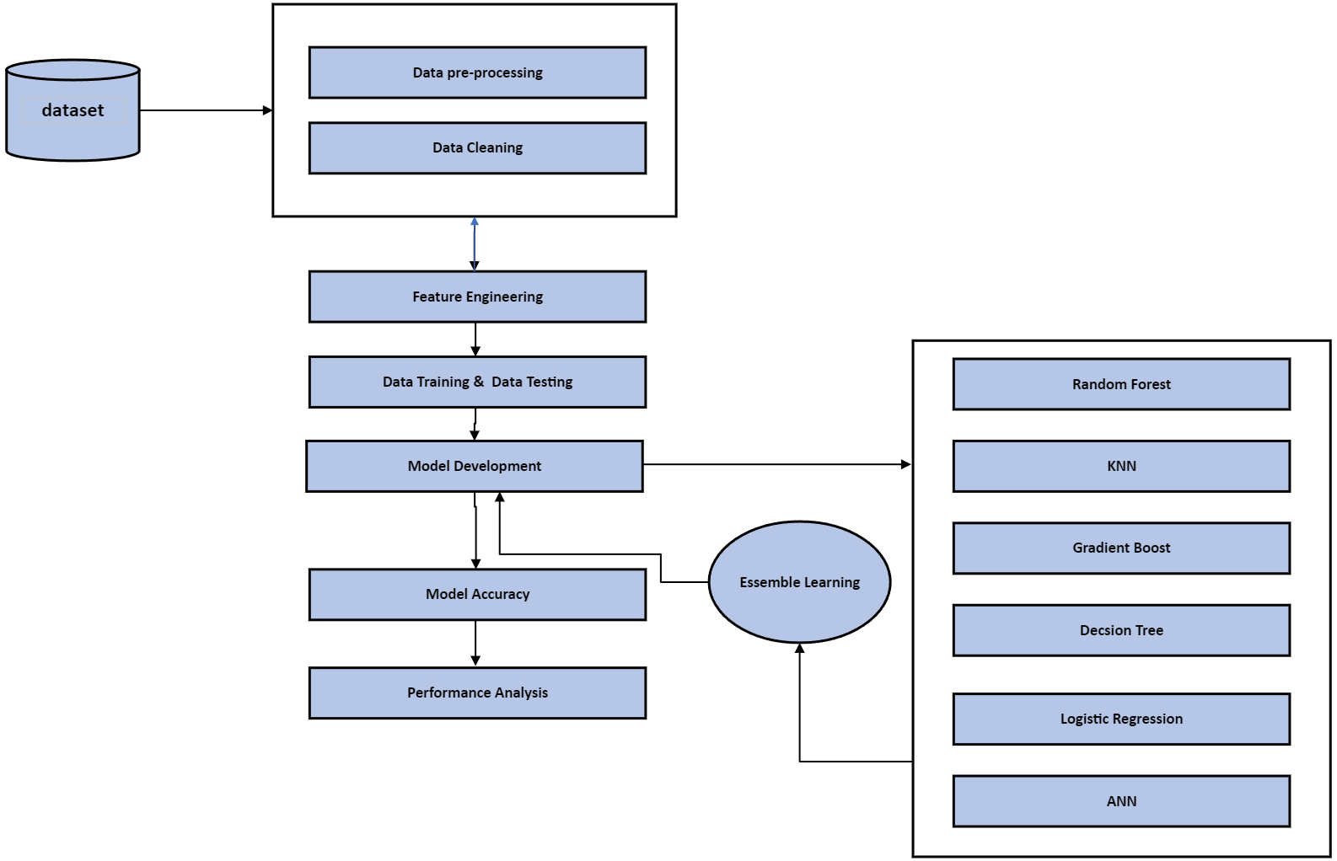
METHODOLOGY
Data Collection: https://www.kaggle.com/alexteboul/diabetes-health-indicators-dataset
Data Preprocessing: Cleaning and normalizing data, probing missing values, feature selection, and engineering.
Model Selection: Choosing appropriate ML models (e.g., Decision Trees, Random Forests, Neural Networks).
Training the Model: Feeding pre-processed data into the models to learn patterns associated with diabetes risk.
Model Validation: Using a split dataset to test the model's accuracy in predicting diabetes risk.
Iteration and Optimization: Refining the model by adjusting parameters and incorporating feedback loops.
Performance Analysis : Measuring and comparing model performance against metrics (e.g. Accuracy, F1 score, precision)

Slide 7
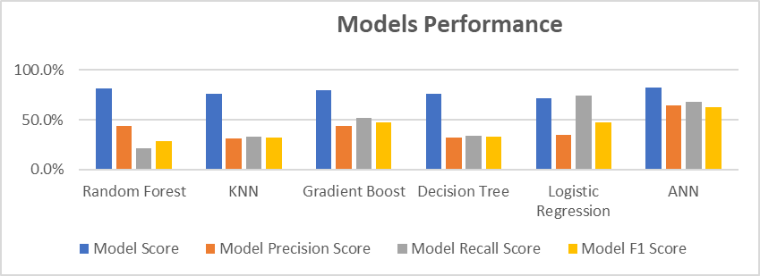
EVALUATION AND RESULTS
Model name | Model Score | Model Precision Score | Model Recall Score | Model F1 Score
Random Forest | 81.6% | 43.5% | 21.3% | 28.6%
KNN | 76.0% | 31.4% | 32.8% | 32.1%
Gradient Boost | 79.9% | 43.3% | 52.2% | 47.3%
Decision Tree | 76.1% | 31.9% | 33.9% | 32.9%
Logistic Regression | 71.5% | 34.7% | 74.0% | 47.3%
ANN | 82.4% | 63.9% | 67.6% | 62.2%

Slide 8

CONCLUSION
Methodology: Evaluated diabetes risk prediction using literature comparison, data analysis, and diverse machine learning models.
Key Finding: Artificial Neural Networks (ANN) emerged in this research as the most effective model for predicting diabetes risk. Although, ML models are limited by constraints such as data quality and privacy issues, they proved to be more effective than traditional means of predicting diabetes.
Research Gaps:
Data Diversity: Need for broader data representation.
Model Interpretability: Importance of understandable models for clinical use.
Feature Engineering: Optimization of feature selection for enhanced prediction.
Future Directions:
Deep Learning: To capture complex patterns in data.
Federated Learning: For privacy-preserving, decentralized learning.
Natural Language Processing: To leverage insights from unstructured clinical notes.
Telemedicine & Remote Monitoring: For real-time, dynamic data collection to enhance data harmonization.
Genomic Analysis: For personalized risk assessments.
Moving forward, integrating advanced analytics with rich datasets will yield more precise, interpretable, and patient-specific models.

Slide 9

Babatunde Abiodun Olusegun | B1605208 | 16th January 2024.
1st Reader: Iqbal Zahid | 2nd Reader: Qiang Guo
.

